Slide 1

Lecture 14： The Graph based SLAM Algorithms
Department of Mechanical Engineering and Automation
Haoyao Chen

Slide 2
Simultaneous Localization and Mapping
A robot acquires a map while localizing itself relative to this map.
Online SLAM problem Full SLAM problem
Estimate map m and current position x_{t} Estimate map m and driven path x_{1:t}

Slide 3
Simultaneous Localization and Mapping
A robot acquires a map while localizing itself relative to this map.
Online SLAM problem Full SLAM problem
Quadratic Update Complexity
Update every time step
Moment Representation
Can’t undo Data Association but easy
Small maps
Offline: over all poses and features (Optimal Approach)
Maximum likelihood
Canonical Representation
Robust Data Association but need inference
Large maps

Slide 4
Graph SLAM
GraphSLAM extends the state vector y with the path x_{0:t}
Example: Groundhog in abandoned mine:
every 5 meters a local map

Slide 5
Acquisition of the information matrix
The observation of a landmark m₁ introduces an constraint:
The constraint is of the type:
Where h(x_{t},m_{j}) is the measurement model and Q_{t} the covariance of the measurement noise.

Slide 6
Acquisition of the information matrix
The movement of the robot from x₁ to x₂ also introduces an constraint:
The constraint is of the type:
Where g(u_{t},x_{j-1}) is the motion model and R_{t} the covariance of the motion noise.

Slide 7
Acquisition of the information matrix
After several steps, a dependence graph appears with several constraints:
The resulting information matrix is quite sparse.
The sum of all constraints in the graph has the form:

Slide 8
Reducing the dependence graph
Removal of the observation of a landmark m₁ changes the constraint between x₁ to x₂ :
The constraint is changed by the following subtraction:
This is a form of variable elimination algorithm for matrix inversion

Slide 9
Reducing the dependence graph
Removal of the observation of a landmark m₃ introduces a new constraint between x₂ to x₄:

Slide 10
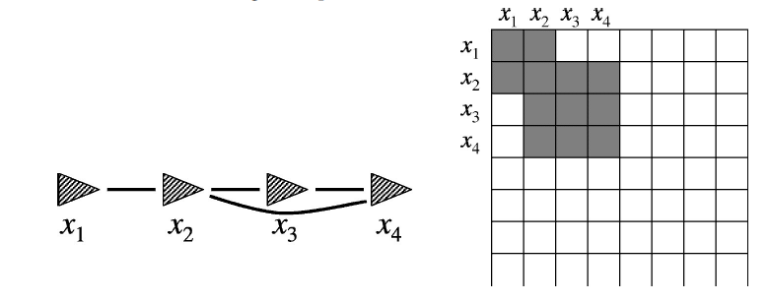
Reducing the dependence graph
The final result:
The resulting information matrix is much smaller. This reduction can be done in time linear in size N

Slide 11
Updating the full state estimate from the path
There is now an estimate of the path robot
This requires to solve a system of linear equations, which is not linear in size t due to cycles (loop closures!).
When found, the map can be recovered. For each landmark m_{j}:
In addition, an estimate of the covariance Σ_{0:t} over the robot path is known (but not over the full state y)

Slide 12
Full Algorithm
Construction -> Reduce for calculation efficiency -> Solve
The previous steps should be iterated to get a reliable state estimate μ:

Slide 13
Any other approaches?
The Full Algorithm Drawbacks:
Very Slow
Local minimum

Slide 14
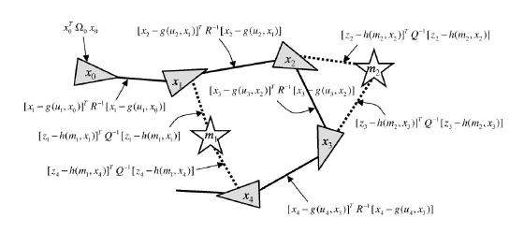
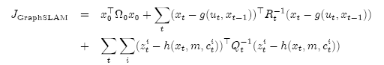
Use a graph to represent the problem:
Every node in the graph corresponds to a pose or an observation of the robot during mapping
Every edge between two nodes corresponds to the spatial constraints between them

Slide 15
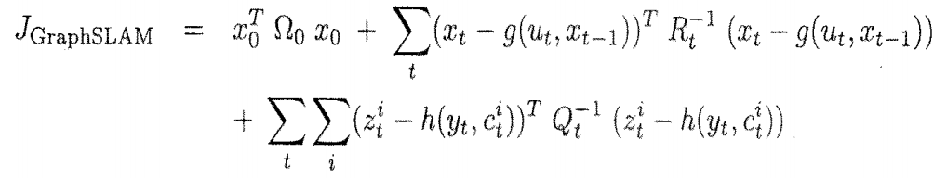
Other Optimization Methods?
Gradient descent,
Levenberg Marquardt,
Conjugate gradient

Slide 16
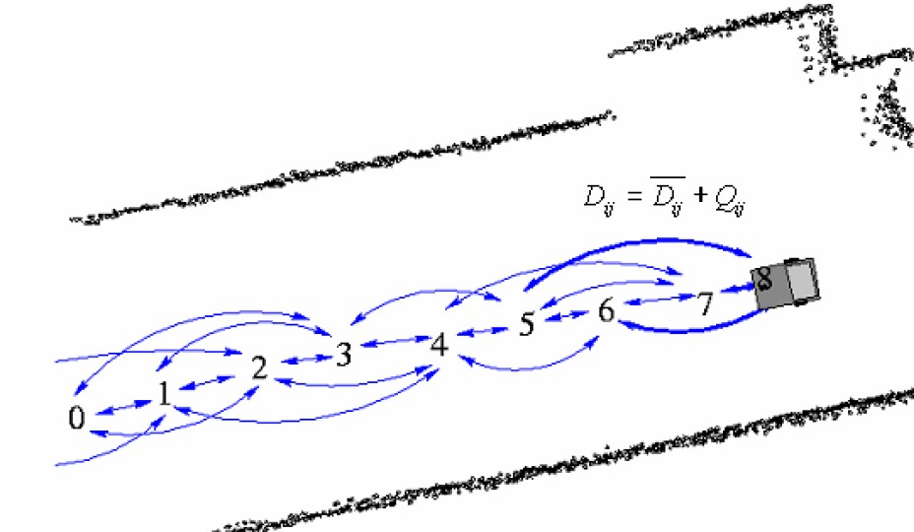
Gradient descent based Graph-based SLAM (Giorgio Grisetti, A Tutorial on Graph-Based SLAM , 2010)

Slide 17
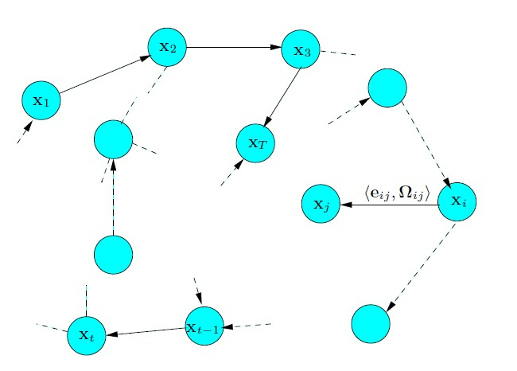
Gradient descent based Graph-based SLAM

Slide 18
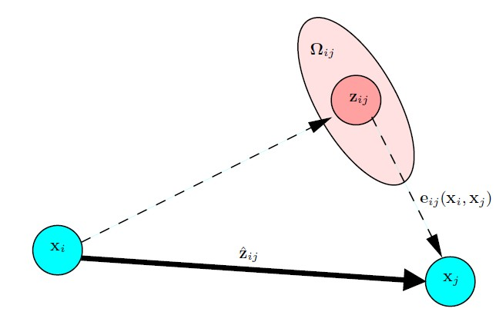
Gradient descent based Graph-based SLAM
Scan matching to obtain z_{ij}
Odometry to obtain predicted z_{ij}

Slide 19
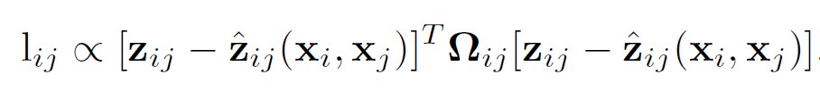
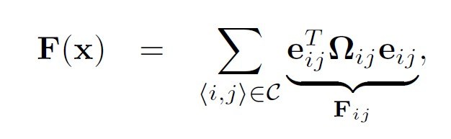
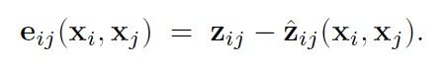
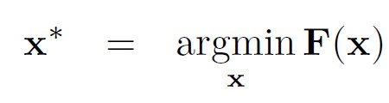
Gradient descent based Graph-based SLAM

Slide 20
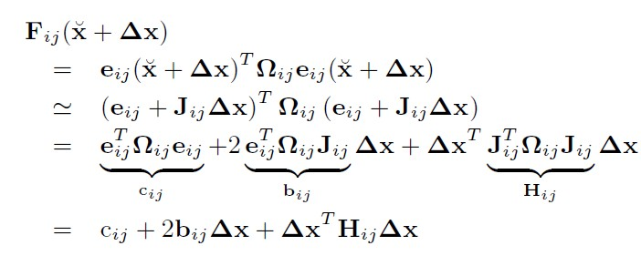
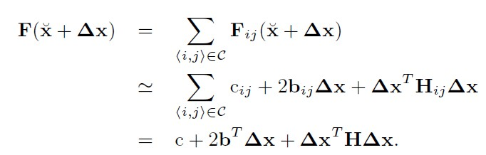
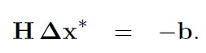
Gradient descent based Graph-based SLAM

Slide 21
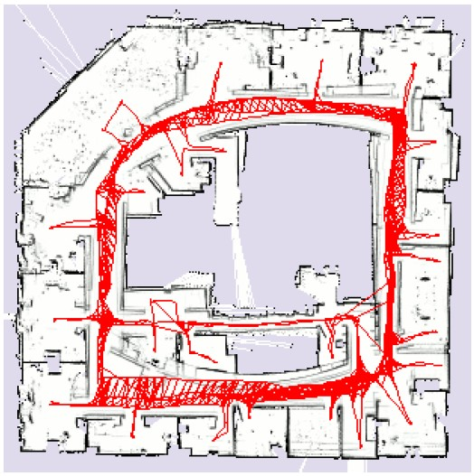
Gradient descent based Graph-based SLAM

Slide 22
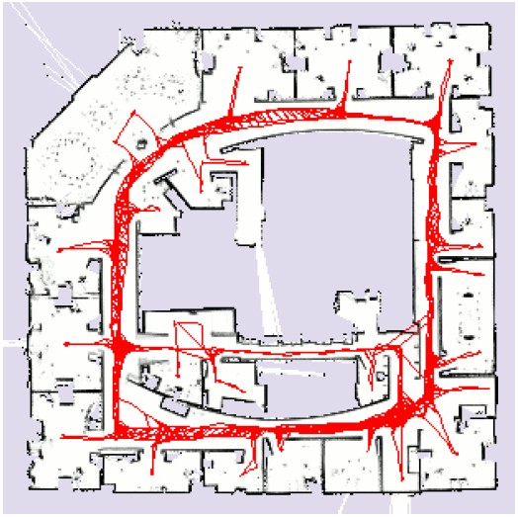
Gradient descent based Graph-based SLAM

Slide 23
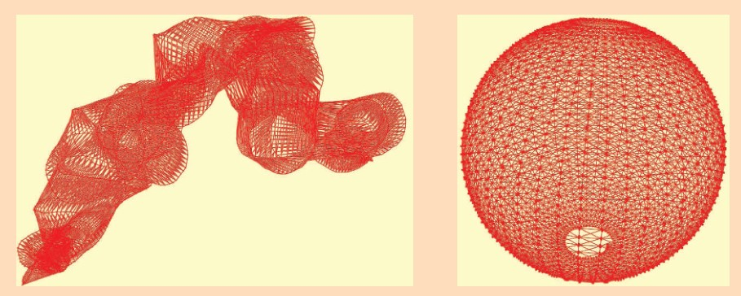

Slide 24
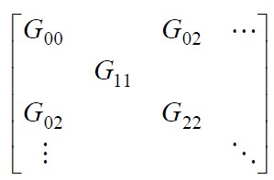
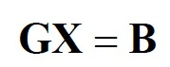
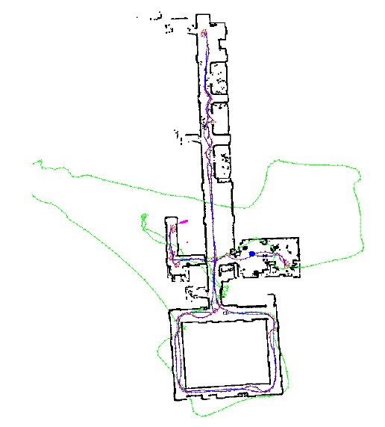
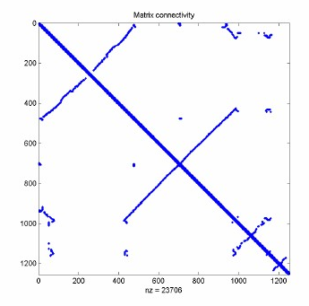
Conjugate gradient based GraphSLAM (Kurt Konolige, 2004, Lu and Milios 1997)

Slide 25
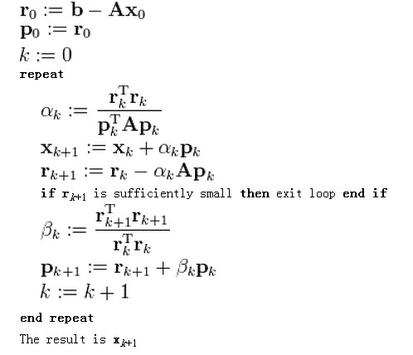
Conjugate gradient based GraphSLAM (Kurt Konolige, 2004, Lu and Milios 1997)
The matrix G is positive, symmetric, and definite. The solution of choice for sparse systems of this type is the conjugate gradient (CG) method.

Slide 26
iSAM

Slide 27
iSAM：incremental Smoothing and Mapping
“iSAM2: Incremental Smoothing and Mapping Using the Bayes Tree” by M. Kaess, H. Johannsson, R. Roberts, V. Ila, J.J. Leonard, and F. Dellaert. Intl. J. of Robotics Research, IJRR, vol. 31, Feb. 2012, pp. 217-236.
“iSAM: Incremental Smoothing and Mapping” by M. Kaess, A. Ranganathan, and F. Dellaert. IEEE Trans. on Robotics, vol. 24, no. 6, Dec. 2008, pp. 1365-1378.
“Square Root SAM: Simultaneous Localization and Mapping via Square Root Information Smoothing” by F. Dellaert and M. Kaess. Intl. J. of Robotics Research, vol. 25, no. 12, Dec. 2006, pp. 1181-1204.

Slide 28
Features
Transform the Probabilistic problem into Least Square Problem
Key tech: Matrix Transformation

Slide 29
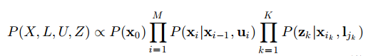
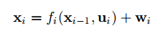
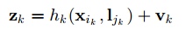
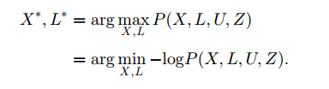
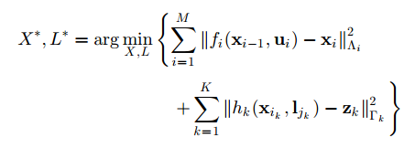
1.Model Transformation

Slide 30
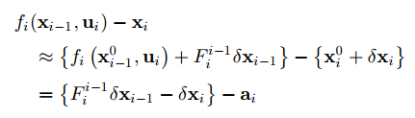
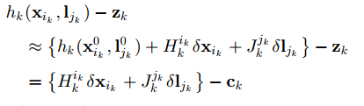
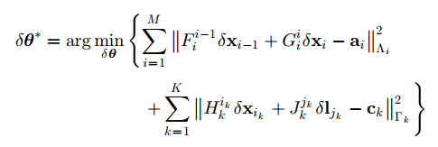

Slide 31
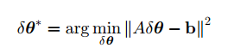
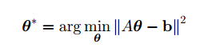
=

Slide 32
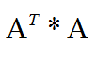
Solve the Least Square
Cholesky Decomposition: We need to calculate
QR Factorization

Slide 33
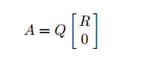
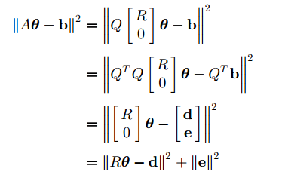
QR Factorization
Upper triangular
Residual of the least squares problem
Back substitution

Slide 34
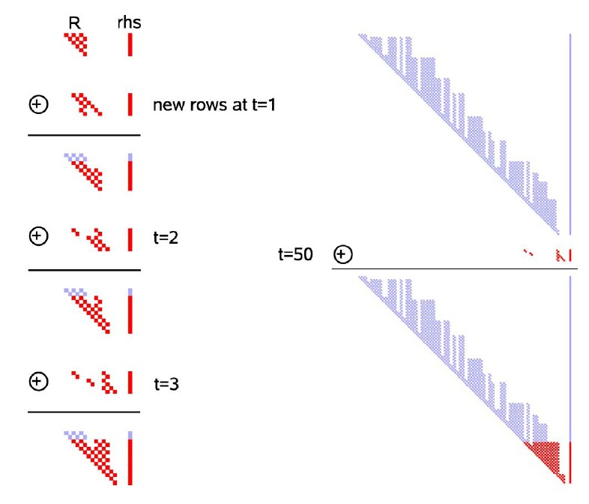
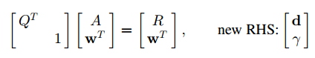
2.Increased Update
Update with new observations
Step 1: Expand the R and d with appropriate number of empty cols and rows
Step 2: Add new measurement rows
Step 3: Zero out the new rows by Givens Rotations (QR Factorization)

Slide 35
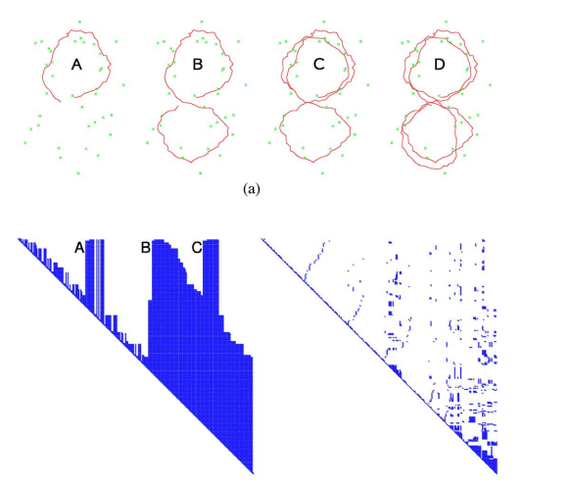
3.Loops and Fill in
Loops result in a significant increase of non-zero entries, named fill-in

Slide 36
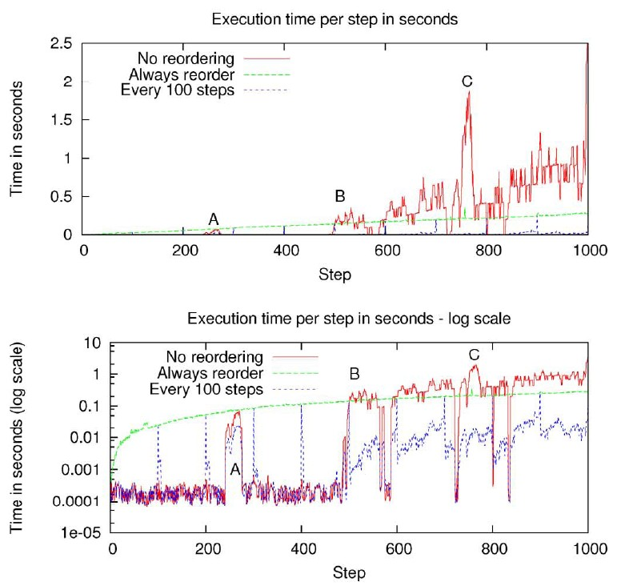
Varible reordering: COLAMD(column approximate minimum degree ordering by Daviset et.al)
Remember the ordering

Slide 37
Summary：
Construct A
QR
Factorization
Update R
……
Update R
Back-substitution
QR Updating
COLMAD Reordering
Nonconverge
Gauss-Newton or LM method
Relinearization
Con
Update R
……
Update R

Slide 38
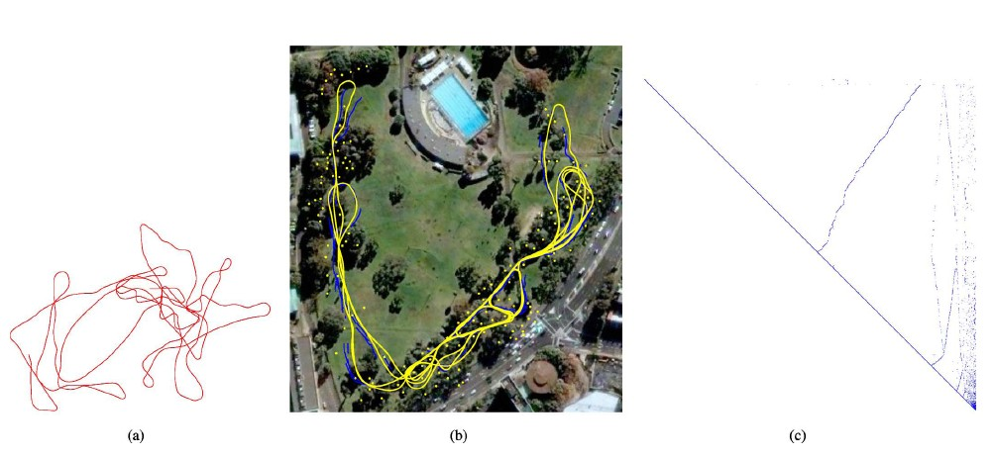
Example

Slide 39
RGBD SLAM

Slide 40
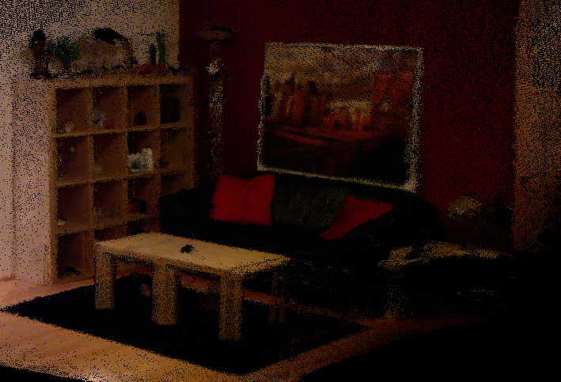
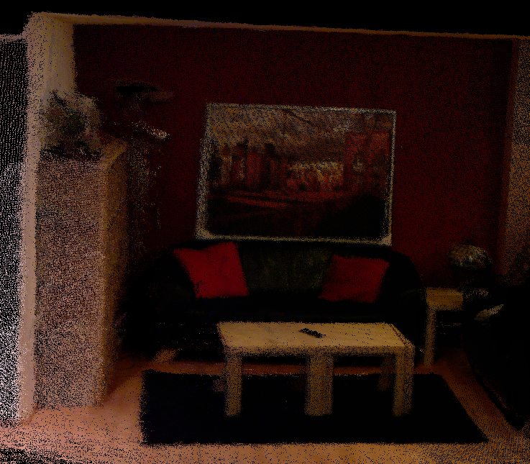
Motivation
Our goal:
Learn 3D models of (indoor) scenes
Applications:
Architecture
Gaming
Archaeology

Slide 41
References
F. Endres, J. Hess, J. Sturm, D. Cremers, and W. Burgard. 3D Mapping with an RGB-D Camera, IEEE Transactions on Robotics, 2013(4).
J. Sturm and N. Engelhard and F. Endres and W. Burgard and D. Cremers. A Benchmark for the Evaluation of RGB-D SLAM Systems, In Proc. of the International Conference on Intelligent Robot Systems (IROS), 2012.
N. Engelhard, F. Endres, J. Hess, J. Sturm, and W. Burgard. Real-time 3D visual SLAM with a hand-held camera. In Proc. of the RGB-D Workshop on 3D Perception in Robotics at the European Robotics Forum, 2011.

Slide 42
Features：
Without odometry information;
Robot Poses Transformation based on Visual Odometry;
Divide the SLAM into independent localization and mapping;
Graph Optimization based Trajectory estimation;
RGB-D camera based 3D color environmental map;
Offline/Real-time SLAM

Slide 43
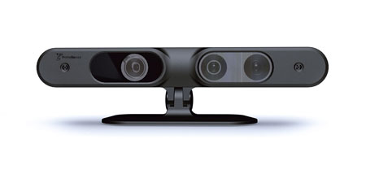
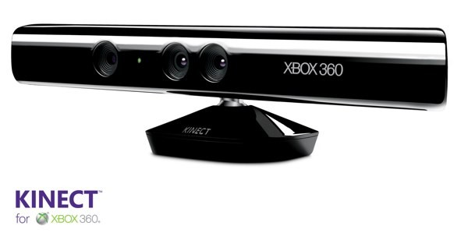
RGBD Cameras—— RGB Color+Depth
Carmine 1.08

Slide 44
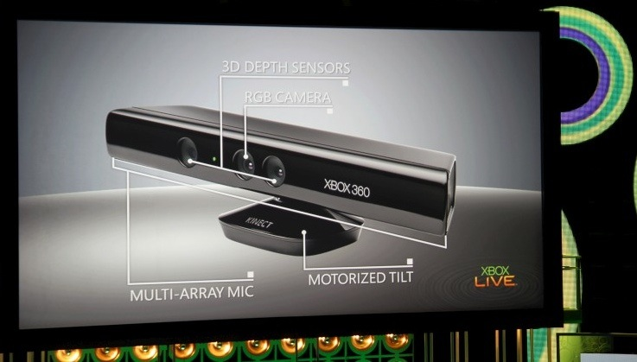
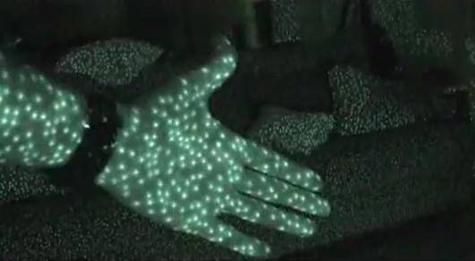
Hardware

Slide 45
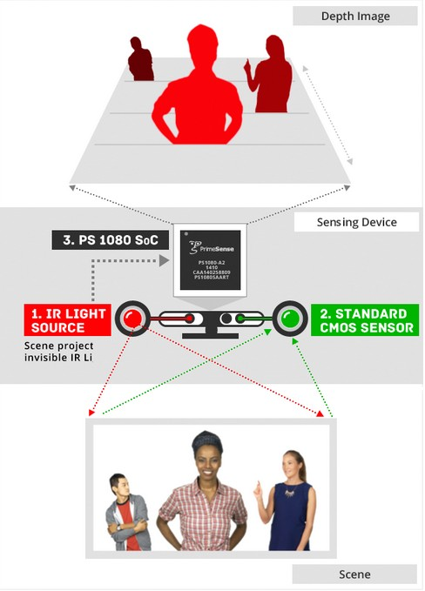


Slide 46
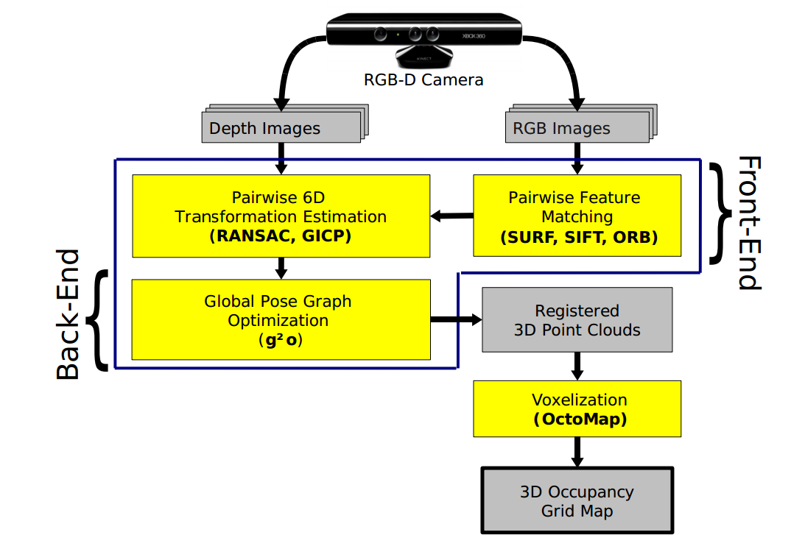
算法流程

Slide 47
Font-End
Objective：constructing pose graph
Approaches: SIFT, SURF based Feature matching to obtain Feature Correspondences
Using RANSAC and ICP to calculate fine transformation matrix
Back-End
Pose graph optimization based on General Graph Optimization (G2O)
Detect Outlier loops
G2o combines several optimization algorithms
Suitable for solutions of nonlinear objective functions.

Slide 48
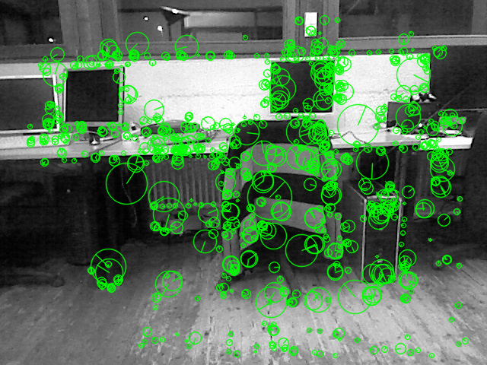
Feature Extraction and Matching
SURF: scale and rotation invariant descriptor
Runtime
600-800 features
OpenCV: 1 sec
SurfGPU: 40 ms
Matching
FLANN
< 15 ms

Slide 49
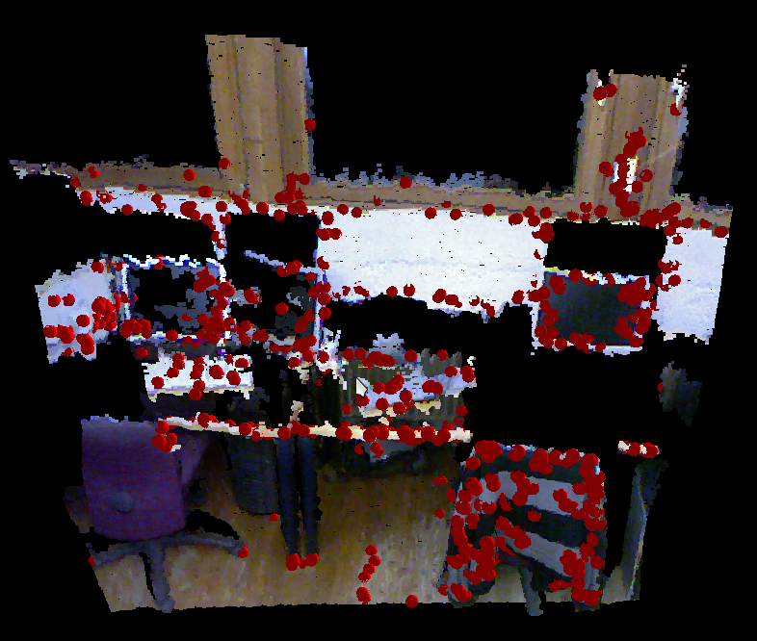
Features in 3D
Associate features with 3D points
Problem: missing data (glass, occlusion)

Slide 50
Estimate Relative Pose
RANSAC: good for estimating models in the presence of outliers
Algorithm:
Find correspondences
Repeatedly sample three correspondences, estimate pose, count inliers (and optimize)
Return pose with most inliers
Runtime: < 5 ms

Slide 51

Correspondences in 2D
Image at time t Image at time t+1

Slide 52
Pose Refinement
Iterative Closest Point
Generalized ICP [Segal, 2009]
Plane-to-Plane metric
Local optimization (prone to local maxima)
Needs good initialization
Runtime: ~500 ms on a sampled subset

Slide 53


Pose Refinement (2)
Without ICP With ICP

Slide 54
Construct Pose Graph
node1
node2
1
SE3
2
pose graph
Time t

Slide 55
Construct Pose Graph
node1
node2
1
SE3
2
SE3
SE3
3
pose graph
node3
Time t+1

Slide 56
Construct Pose Graph
node1
node2
1
SE3
2
SE3
SE3
3
SE3
SE3
SE3
4
pose graph
node3
node4
……
Time t+2
……

Slide 57

Loop Closing
Summation of incremental error → drift
Detect loops and average errors
Pose graph optimization [Grisetti, 2010]
System is over-determined
Needs to find the best globally consistent alignment
Corrected poses

Slide 58

Example Pose Graph
Axes = estimated camera poses
White edges = relative transformations

Slide 59

Video (1/3)

Slide 60
Video 2/3

Slide 61
Video 3/3

Slide 62
Conclusions
Visual SLAM system
SURF feature matching
RANSAC pose estimation
ICP pose refinement
Pose graph optimization
Real-time
Open-source (in ROS) + Tutorial available:
http://www.ros.org/wiki/openni/Contests/ROS 3D/RGBD-6DSLAM

Slide 63
Further Work
Ground truth evaluation using a Motion Capturing
Improve speed of ICP
Parallelization

Slide 64
Homework
Read the paper:
iSAM: Incremental Smoothing and Mapping, Kaess et al. 2008, TRO.
Write a detailed report

